Slide 1

DevOps on Azure
Divya Vaishnavi
Sr. Program Manager
@divyavaishnavi
trends: #VSTS; #GAB2018 #GlobalAzure

Slide 2
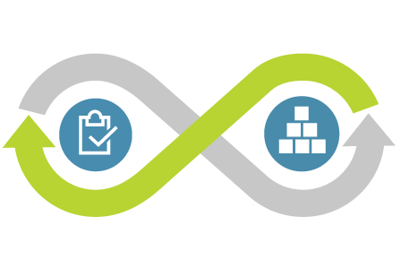
What is DevOps?
DevOps is the union of people, process, and tools to enable continuous delivery of value to our customers.
Increase flow of value
Shorten cycle times
Continuously Improve
Notes:
Poll on Devops, devops practioners, apps they build, tools they use, why devops
Our definition of DevOps is the union of PEOPLE, PROCESS and TOOLS to enable the continuous delivery of value to our CUSTOMERS

Slide 3
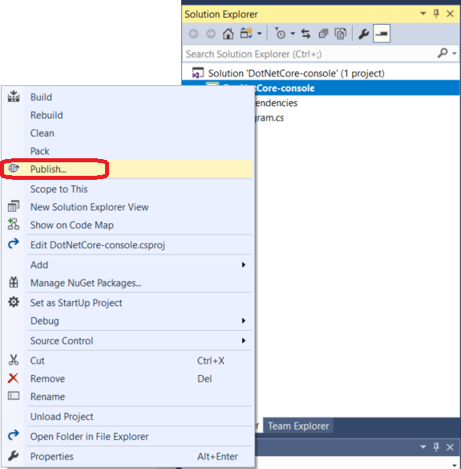

Slide 4
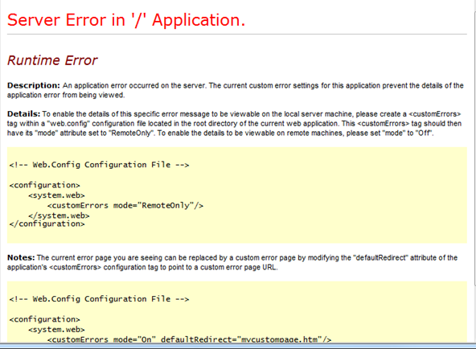
Notes:
How many have seen this… this is a simple mistake and common
Imp is how quickly u can recover, how can u avoid
Payment application and you see this error and now u r unsure did your money go not go.. Would you use this app again
Losing customers, losing money and losing brand…
Mistakes are human but u can put the check and balances in place to ensure they r least, how can u recover from downtime, manual deployments, turnaround time from mistakes… deployments

Slide 5
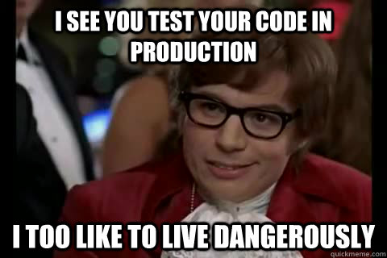

Slide 6
What should you do?

Slide 7


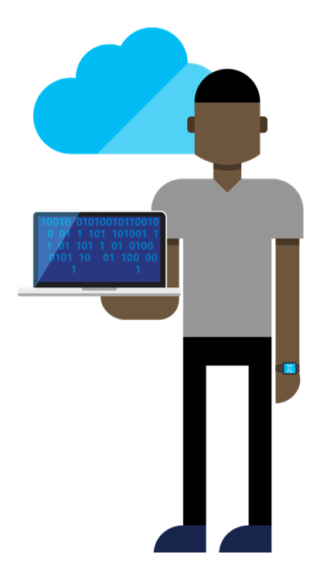

Continuous Delivery
SOURCE CONTROL
BUILD
TEST
PACKAGE
DEVELOPMENT
TFVC
STAGING
DEV
OPS
PRODUCTION
Notes:
What is CD, one of the best practices which helps you automate ur deployment e2e
From source control, automated build, as many tests as possible and generate a package
Package can be zip, exe, docker image for containers

Slide 8
Continuous Delivery
SOURCE CONTROL
BUILD
PACKAGE
DEVELOPMENT
TFVC
STAGING
DEV
OPS
PRODUCTION
Notes:
Build and test together is CI

Slide 9
Continuous Delivery
SOURCE CONTROL
CI
PACKAGE
DEVELOPMENT
TFVC
STAGING
DEV
OPS
PRODUCTION

Slide 10
Continuous Delivery
SOURCE CONTROL
CI
PACKAGE
PIPELINE
DEPLOYMENT
Notes:
Systems involved

Slide 11



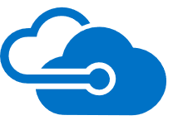
Continuous Delivery
SOURCE CONTROL
CI
PACKAGE
PIPELINE
DEPLOYMENT
OctoPack
Octopus Deploy ASP.NET Web App

Slide 12

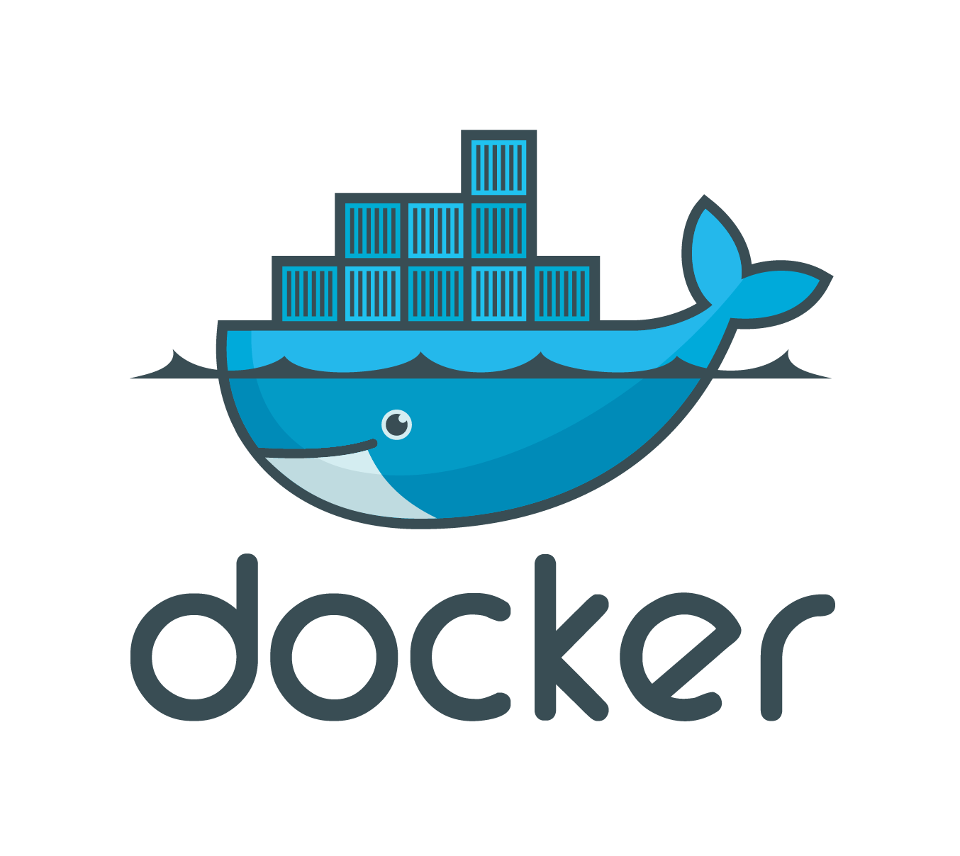
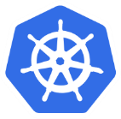
Continuous Delivery
SOURCE CONTROL
CI
PACKAGE
PIPELINE
DEPLOYMENT
Azure Container Registry to Azure Container Service with Kubernetes

Slide 13

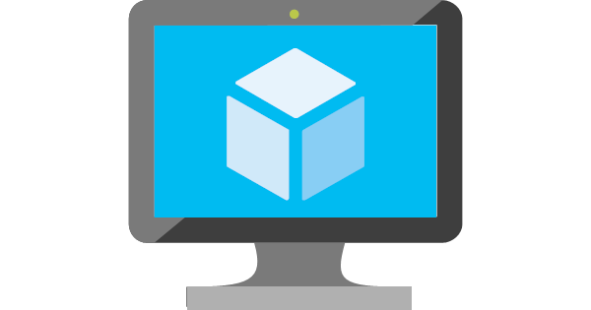

Continuous Delivery
SOURCE CONTROL
CI
PACKAGE
PIPELINE
DEPLOYMENT
Azure VM Scale Sets with Packer
Notes:
If you have an app that you haven’t containerized, you can deploy to auto-scaling sets of VMs using Azure VMSS. We worked with Hashicorp to extend Packer which is an OSS tool to bake both Windows and Linux Azure VHDs efficiently.

Slide 14
Continuous Delivery with VSTS
Any app, any developer, any platform
Best DevOps offering for targeting Azure
Enterprise class – grows with customer
Fully integrated with OSS, Jenkins, GitHub etc
Lowers the barriers to entry
Notes:
VSTS + Azure = Best DevOps Offering
VSTS brings to you a simple experience to configure continuous delivery on Azure app services.
Let us say a website is under development. Traditionally the way to test the website on Azure was to perform publish on a need basis.
By configuring CD, your customers can ensure all changes made by anybody in the team automatically get deployed and tested on Azure.
Demo: Show configure CD on new ASP.net web app from VS IDE. After configuration, show the build definition and release definition.
Code: https://releasemanagementpm.visualstudio.com/DevOPS/_git/AspNet
Configure on an existing application for which a pipeline is not yet configured [aspnewdevops-dev-as]
Takes approximately 6 minutes to configure and complete first build and release
Make a change and rerun would take ~ 5 minutes more
-- While this is running, we can talk about the set of tasks related to app services available in the catalog (App Service Manage etc.)
-- And how this is a simple pipeline that can be configured to grow
-- Show add environment experience by cloning the environment etc.
-- Show the Canary RD () as a reference
If you are a CLI person, you can do this configuration using Azure CLI as well.
From Azure portal, we take this one step further.
Use application aspnewdevops-dev-ib, show configuration of continuous deployment
Show load test configuration and use of staging slot
Talk about the best practices involved here. Why run load testing on a separate site and not the same one or a slot of the same.

Slide 15
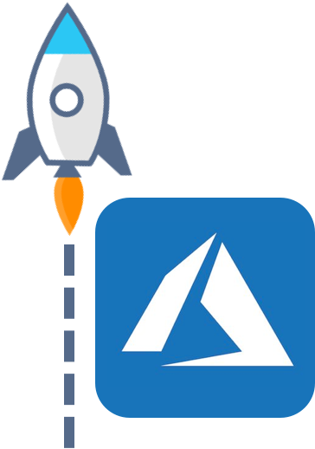
Where to start ?
VSTS Portal
Azure Portal
Visual Studio 2017 IDE
AZ CLI
PowerShell
Others..

Slide 16
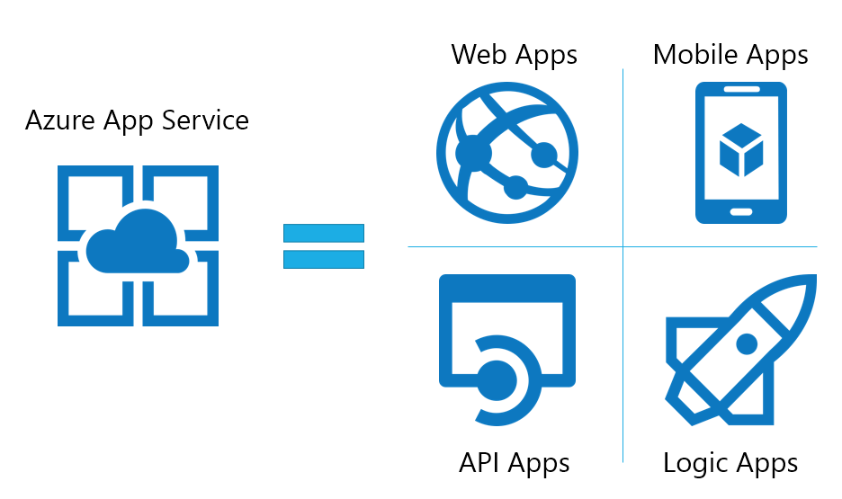
Azure App Services
Widely popular Azure Service
1 M+ active sites
Growing ~10% MoM
Notes:
With Azure app Service, you can host webapps, mobile apps, API apps, Logic apps, BOTs etc. on Azure

Slide 17
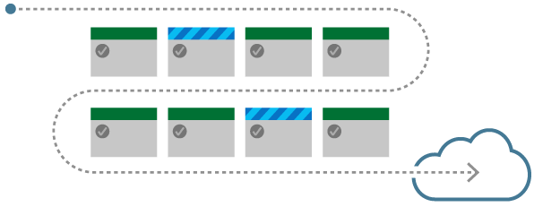
Demo
Getting started made easy:
Azure DevOps Project
Notes:
Python sample project - https://ms.portal.azure.com/#@microsoft.onmicrosoft.com/resource/subscriptions/4cef6782-19b2-4d4b-bfcb-aa44cacb5539/resourceGroups/VstsResourceGroup-DivaPython/providers/microsoft.visualstudio/account/divavso-us/project/PythonProject
Show get started
Jump to this project
Make change
Deploy
Change RD
Talk about RD – release gate
Talk about AI

Slide 18

Get started fast on Azure with any language, any platform
Built in support for popular application frameworks
Deploy to platform of your choice
Get fully integrated CI/CD pipeline automatically
Application Insights integration
Notes:
Python sample project - https://ms.portal.azure.com/#@microsoft.onmicrosoft.com/resource/subscriptions/4cef6782-19b2-4d4b-bfcb-aa44cacb5539/resourceGroups/VstsResourceGroup-DivaPython/providers/microsoft.visualstudio/account/divavso-us/project/PythonProject
Show get started
Jump to this project
Make change
deploy

Slide 19
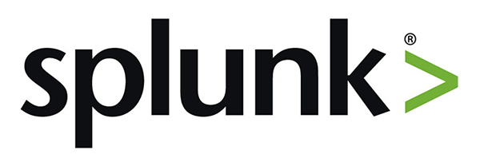




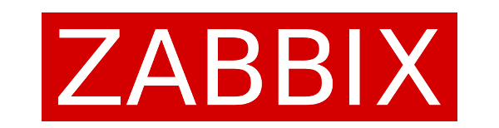
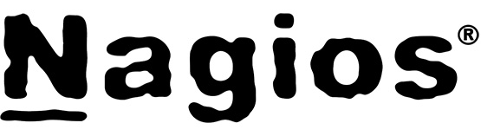
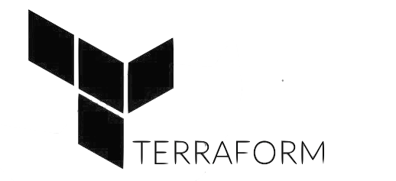



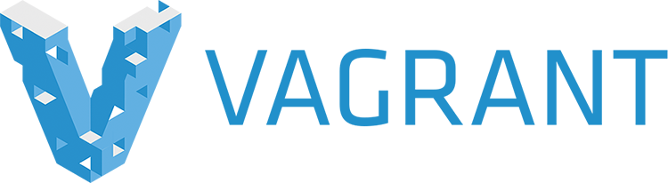
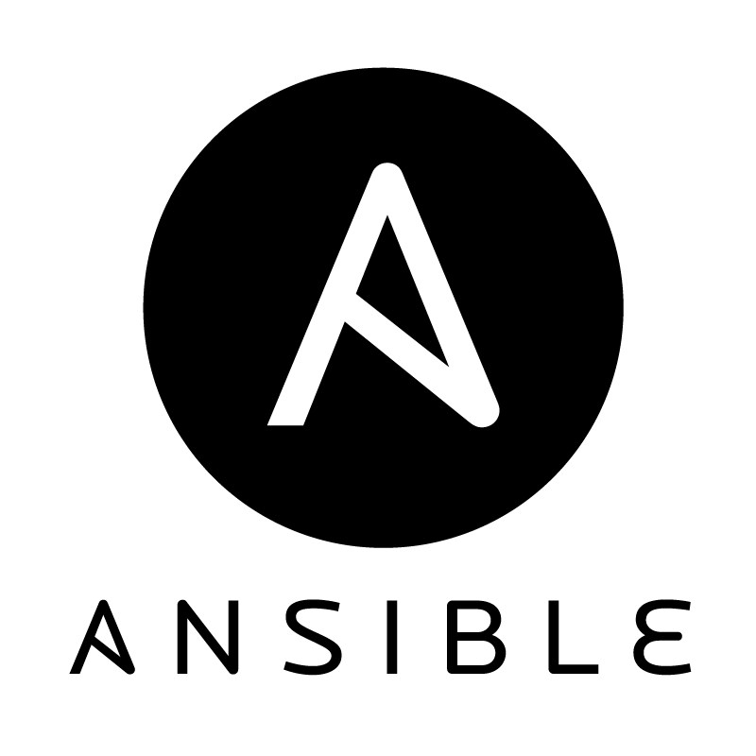

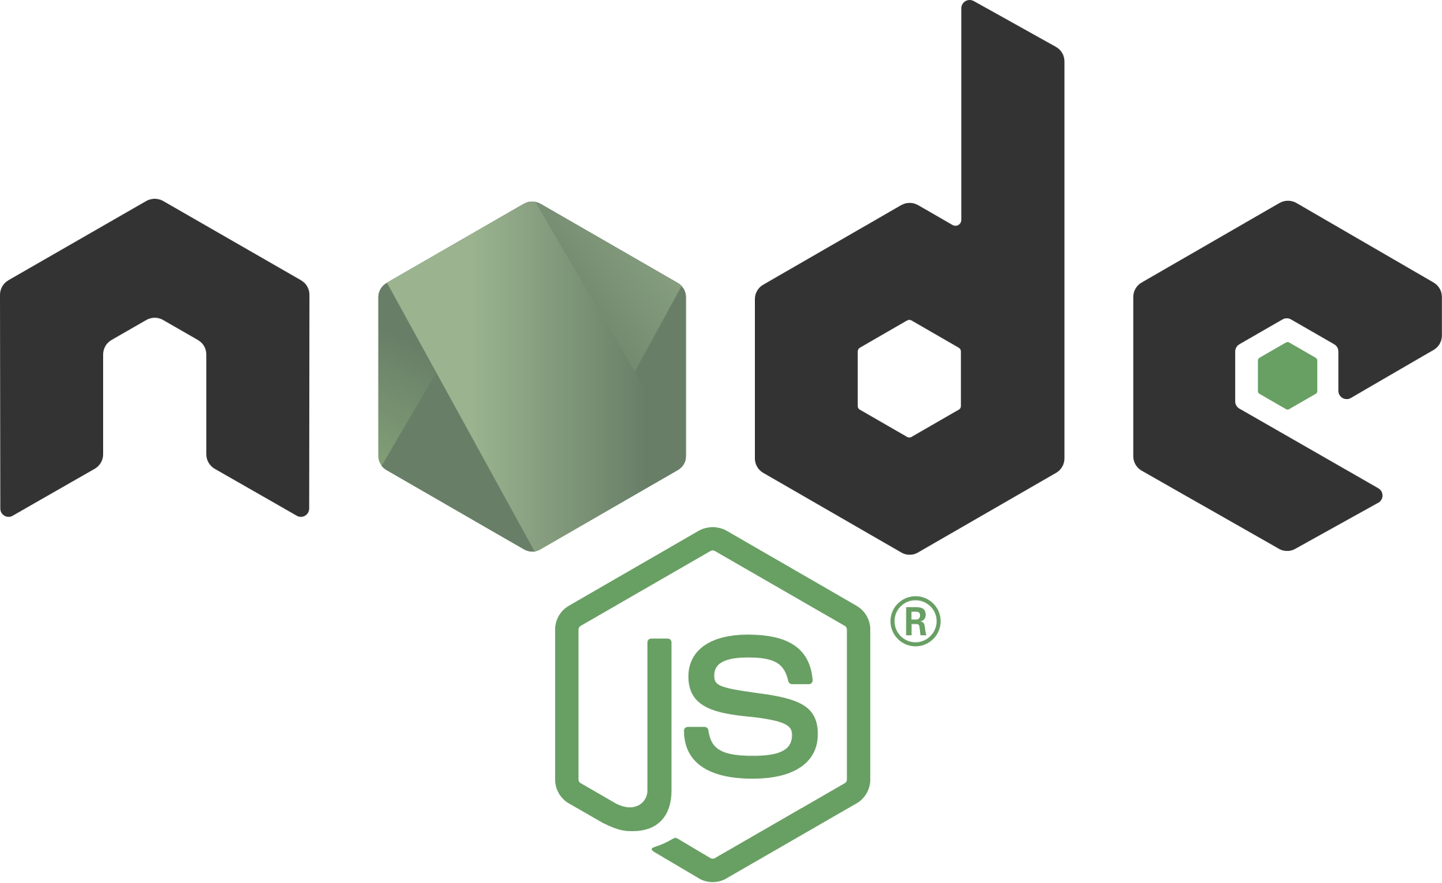
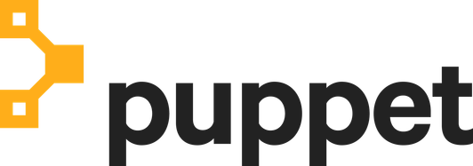
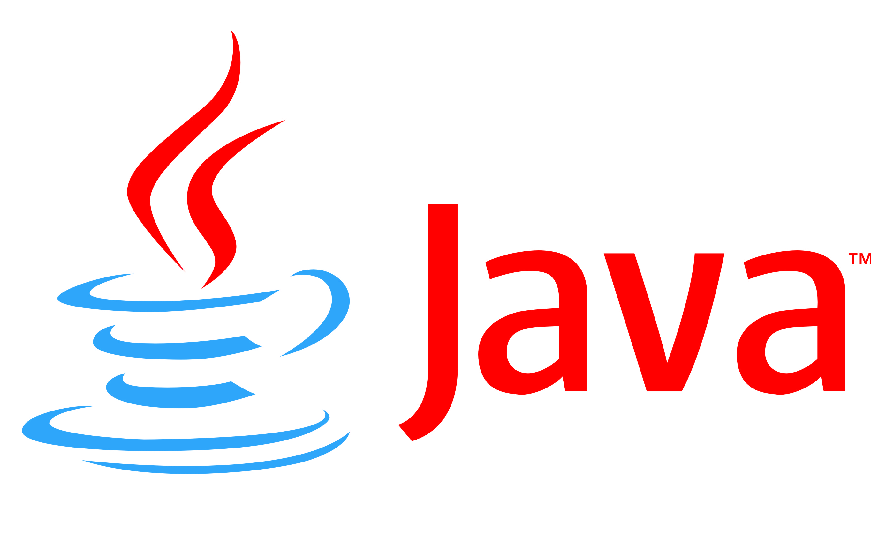
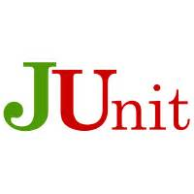
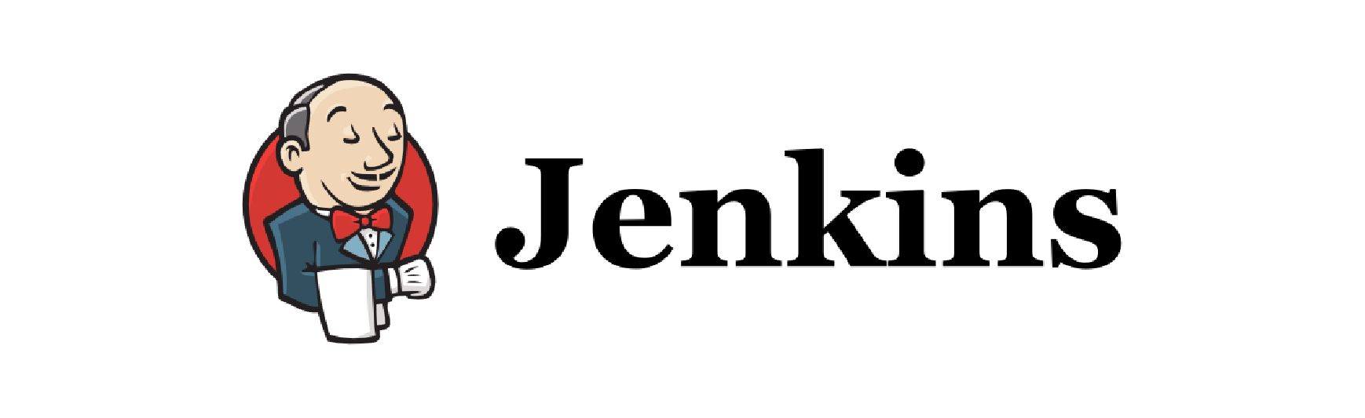

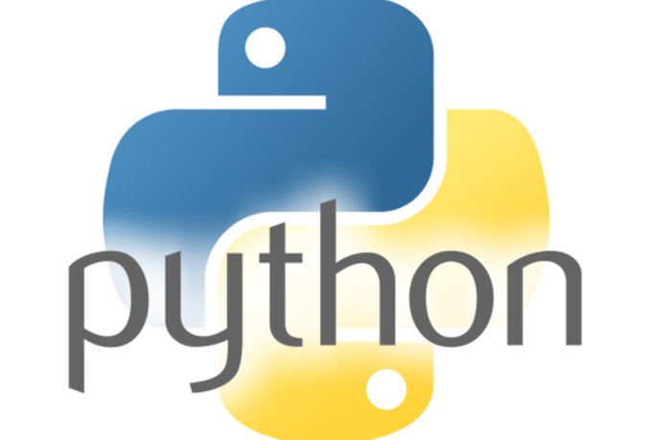

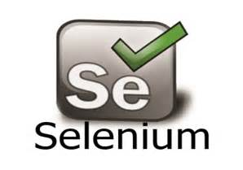
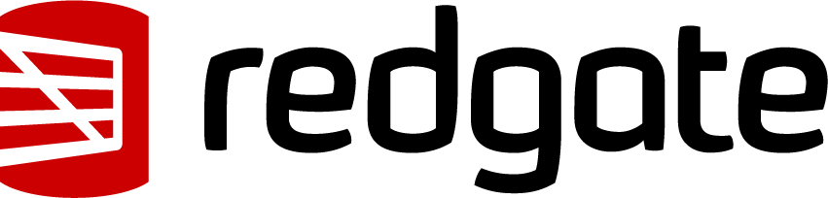

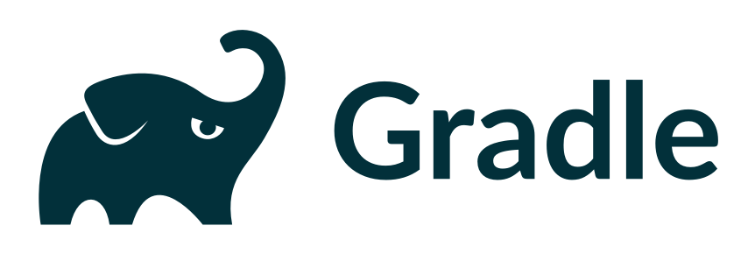
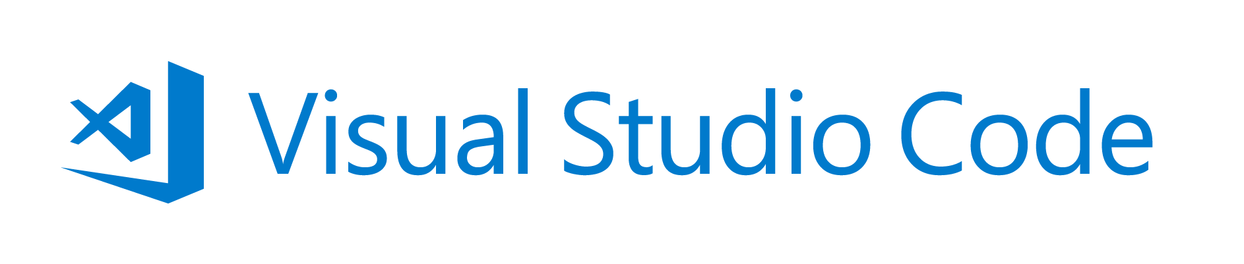
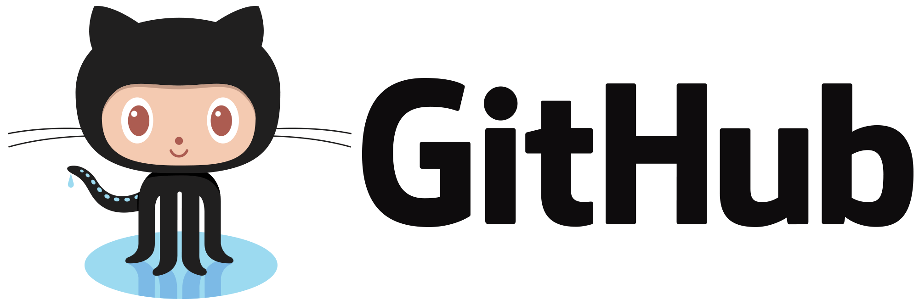
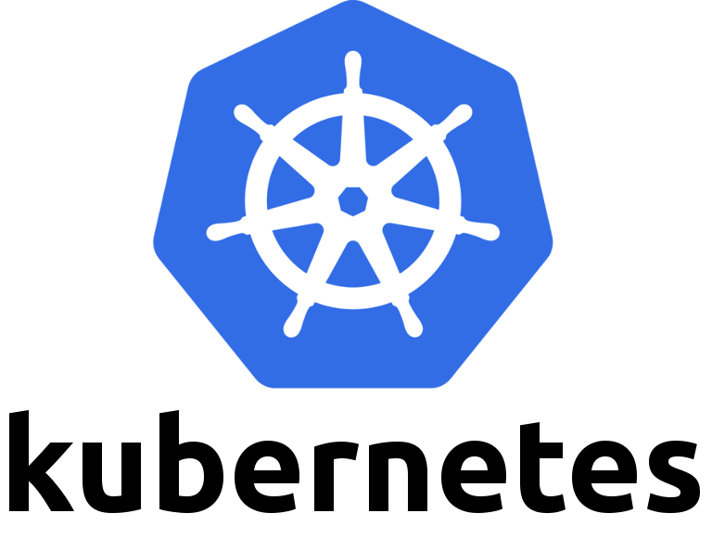
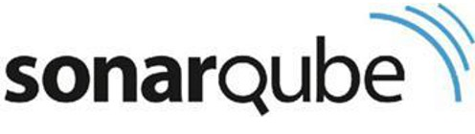


DevOps with Azure & VSTS
Monitor and learn
Feedback
Application Insights
Monitor
Automated functional testing environment
Pre-production environment
Track progress
Plan work
VSTS
Plan and track
Release
Manage work
Project starts
Integration testing environment
Staging environment
Write code
Visual Studio
Unit testing
Version control
Build
Build verification
Develop and test
Notes:
Objective:
Azure has you covered for all your container needs.
Key talking points:
Whether you’re running Linux or Windows Server containers, we have VM extensions to support running your Docker containers on those VMs.
Our own Service Fabric and other Microservice PaaS platforms that also support containers are available, including Pivotal Cloud Foundry and Red Hat OpenShift
The Azure Container Service provides a really fast way to get containers into production with a choice of popular open source container orchestration solutions: DC/OS or Docker Swarm
And we also have a rich and growing set of partner technologies in the Azure Marketplace including Docker, Mesosphere, Kubernetes and more.
Azure has all your container needs covered from development through to large scale production.

Slide 20
Demo 3
CD for Azure App Services
Notes:
Add new environment
Db support
Bring your own code

Slide 21
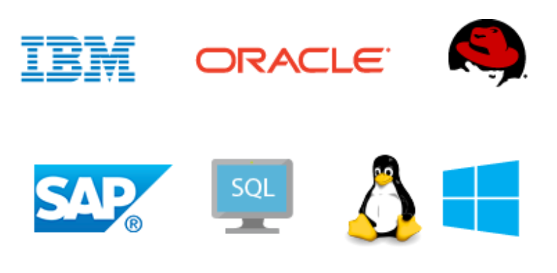
Azure Virtual Machines
Any OS, Any workload
Notes:
Azure App Services is a PaaS, platform as a service. It truly embraces cloud and lets software up there manage the application.
However, there is a large pool of applications today that run on physical/ virtual machines.
Those applications are what made Azure Virtual Machines super popular. You can get a VM with a configuration and platform of your choice within minutes.

Slide 22
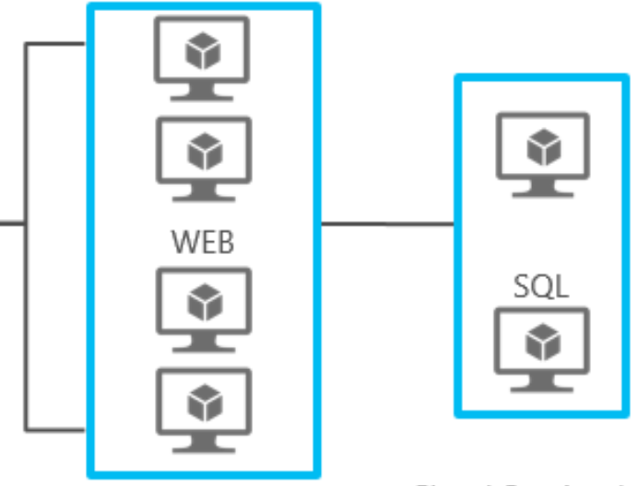


Deployment Groups
Movement of bits
Local Execution
Rolling Deployments
Traceability
Scalability
Notes:
IaaS deployment challenges
Unlike PaaS where Azure abstracts everything, this ends up being like old school
Orchestration needs to go over the boundaries of machines, move the bits around and run scripts locally
ARG → Deployment Group → Fabfiber RD → Rolling deployment policy → Create release → Load Balancer → VM extension + ARG task
Deploying to IaaS machines however comes with it’s own set of challenges. There is no single command that I can now run, telling Azure to deploy. I need to know how to move the bits to each of the machines and execute the deployment scripts on those machines locally.
Moreover, when you have multiple such apps hosted in a single subscription, organizing the machines so as to now cause accidents is equally important. It is like have racks of servers, where each rack contains servers for different applications. Naming scheme, physical organization, etc. all those lab management techniques, now need to applied to the virtual environment exposed by Azure.
Azure provides resource groups as means to group related resources and configure network/security rules against the group as a whole.
Here I have an application that consists of a web front end and a database backend. 4 web servers and 2 db servers.
I have created an Azure resource group for these and tagged the machines based on the role they play for my application.
While configuring CD for the application, we do not want to give up this grouping.
Introducing deployment groups.
Here I have a deployment group that maps 1:1 with the configured Azure Resource Group.
The machines in the resource group interact with VSTS by means of a light weight agent configured on them.
Configuring an agent is super simple. You can do so from Azure by means of installing the VSTS VM extension.
In this case, I have already configured the agent. Let us look at the release definition for deploying this application.
<walk through the phase properties and the role they play>
Create a release and show live logs, rolling deployments etc.
However, this is not a true representation of a production application deployment. In production, each of these machines is bearing some of the customer load and those folks could see a downtime at the time of deployment.
To handle such cases, customers include a load balancer in their Azure resource groups. The load balancer controls the routing of traffic to target machines.
In such a scenario, the definition would look slightly different. Each machine needs to be removed from the load balancer before being updated and joined back to it after the update is complete. That also means that if we remove too many nodes from the load balancer then customers can experience availability issues with the application. Hence, a one at a time strategy is recommended.
There are other means to configure the agents besides the VM extension. VSTS offers an ability to auto-configure agents on machines provisioned as a part of the deployments. In the Azure Resource Group task, you can provide inputs to auto-configure the agents.

Slide 23
Demo 4
Virtual Machines using
Deployment Groups
Notes:
Demo #1 – Pre-configured release definition (IIS + SQL) .. Execute a release
Demo #2 – Provision, Configure, Deploy using ARG

Slide 24
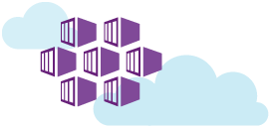
Azure Container Services (AKS)
Move your workloads to cloud
Manage container applications on Azure
Use any of the popular open source tooling
Notes:
Containers enable application developers to easily deploy applications and the related infrastructure across multiple environments. Azure offers a hosting solution which is compatible with all popular open source tooling, so that you can continue to manage your applications using familiar tools.
Containers address the challenges of application portability, scale and agility.
You can scale and orchestrate the applications using DC/OS, Kubernetes or Docker Swarm.

Slide 25
Demo 5
Containers - Kubernetes
Notes:
VSTS enables customers to configure continuous delivery for container applications hosted in Azure.
Here we have an ASP.net Core MVC application. We’ve dockerized it so that we can create an image for the application and make it portable. The image can then be applied to multiple environments without needing to rebuild the image again.
Code → https://releasemanagementpm.visualstudio.com/DevOPS/_git/k8s-docker-core
BD → https://releasemanagementpm.visualstudio.com/DevOPS/_build/index?definitionId=73&_a=completed
RD → https://releasemanagementpm.visualstudio.com/DevOPS/_release?definitionId=8&_a=releases
App → http://13.84.155.190:8080/
The tasks available in the catalog with VSTS enable you to build images, push the images to registries in Docker/ Azure/ Google cloud, and deploy the same to a platform of your choice.

Slide 26
Bonus Demo
Release Gates - Twitter

Slide 27
In review: session objectives and takeaways
Objectives
Understand what is continuous delivery and how to do it for Azure
Understand how you can achieve Continuous Delivery for various Azure resources - Web Apps, VM, Containers
Takeaways
VSTS provides best Azure DevOps Solution
Actions
Try out DevOps Projects
Use DevOps tools to position Azure as a developer-friendly platform
Notes:
This slide is recommended as a final slide to recap the objectives of the session to remind attendees what you said would be covered and to highlight that you did indeed cover those points.
LEARNING OBJECTIVES:
Match the objectives covered on the required Objective slide at the beginning of your presentation.
KEY TAKEAWAYS: Bullet points highlighting the primary information sellers should be able to recall from the session to help them perform in role (e.g. practical guidance, tips, suggested behavior changes.)
Please Note: Key Takeaways are not required to be noted in this slide for Group Discussions (formerly known as Chalk Talks) or Workshop sessions; however, takeaways should be captured real time by the facilitator during the session and those key points should be emphasized during the discussion or workshop.
ACTION ITEMS: Next steps to put their learnings into action. If you have questions, please contact your Track PM.

Slide 28
Session resources
aka.ms/devops DevOps at Microsoft
aka.ms/whatisdevops Your guide through theory and implementation of DevOps
aka.ms/devopsassessment DevOps Self-Assessment
Microsoft Ready content
https://digital.microsoftready.com/
Notes:
Use this slide to share additional content available that attendees should know about. In this section you can call out whitepapers or websites that you and your team have created.

Slide 29
Q&A
If you have questions please proceed to the Q&A MICROPHONE located in your session room.
Notes:
Display this slide during session Q&A and direct attendees to use the Q&A microphone located in the session room:
Digital Ready session recordings cannot capture Q&A unless it is spoken using the microphone
Attendees in the back of the room may not be able to hear a question from someone in the front of the room
SPEAKERS MUST REPEAT THE QUESTIONS IF THE ATTENDEE IS NOT USING THE Q&A MICROPHONE

